Slide 1
Introduction to Logic Programming with Prolog

Slide 2
Prolog
Prolog is a declarative language
A program is a collection of axioms from which theorems can be proven.
  Rather than describing how to compute a solution, a program consists of a data base of facts and logical relationships (rules).
  Rather then running a program to obtain a solution, the user asks a question. When asked a question, the run time system searches through the data base of facts and rules to determine (by logical deduction) the answer.

Slide 3
Logic Programming
Axiom are written in a standard form known as Horn clauses
  A Horn clause consists of a consequent (head H) and a body (terms B_{i})
  H ← B₁, B₂,…, B_{n}
  Semantics: when all B_{i} are true, we can deduce that H is true

Slide 4
Resolution
Horn clauses can capture most logical statements
  But not all
The derivation of new statements is known as resolution
  The logic programming system combines existing statements to find new statements
  For instance,
  C ← A, B
  D ← C
  D ← A, B
A and B imply C
If we know that A and B imply C,
and that C implies D,
then we can deduce that A and B imply D

Slide 5
Example
flowery(X) ← rainy(X)
rainy(Rochester)
flowery(Rochester)
Variable
Predicate Applied to a Variable
Predicate Applied to an Atom
Free Variable X acquired value
Rochester during the resolution
This is known as Unification

Slide 6
Prolog
PROgramming in LOGic
It is the most widely used logic programming language
Its development started in 1970 and it was result of the collaboration between researchers from Marseille, France, and Edinburgh, Scotland
Main applications:
  Artificial intelligence: expert systems, natural language processing, …
  Databases: query languages, data mining,…
  Mathematics: theorem proving, symbolic packages,…

Slide 7
A Prolog Program
The program, sometimes called Database is a text file (*.pl) that contain the facts and rules. It contains all the relations needed to define the problem.
When you launch a program you are in query mode represented by the ? – prompt. In query mode you ask questions about the relations described in the program.
When Prolog is launched the ?- should appear meaning you are in query mode. In SWI-Prolog you can load a program by typing the command [file]. when the file containing your program is file.pl. When you have done this you can use all the facts and rules that are contained in the program.

Slide 8
SWI-Prolog
We will use SWI-Prolog for the Prolog programming assignment
  http://www.swi-prolog.org/
After the installation, try the example program
  ?- [likes].
  % likes compiled 0.00 sec, 2,148 bytes
  Yes
  ?- likes(sam, curry).
  No
  ?- likes(sam, X).
  X = dahl ;
  X = tandoori ;
  X = kurma ;
Load example likes.pl
This goal cannot be proved, so it assumed to be false (This is the so called Close World Assumption)
Asks the interpreter to
find more solutions

Slide 9
Example
Program
location(desk, office).
location(apple, kitchen).
location(flashlight, desk).
location('washing machine', cellar).
location(nani, 'washing machine').
location(broccoli, kitchen).
location(crackers, kitchen).
location(computer, office).
Query
?- location(apple, kitchen).
yes

Slide 10
Prolog Programming Model
A program is a database of (Horn) clauses that are assumed to be true.
The clauses in a Prolog database are either facts or rules. Each ends with a period.
A fact is a clause without a right-hand side.
  rainy(asheville).
A rule has a right-hand side.
  snowy(X) :- rainy(X), cold(X).
The token :- is the implication symbol.
The comma (,) indicates “and”

Slide 11
Prolog Clauses
A query or goal is a clause with an empty left-hand side. Queries are given to the prolog interpreter to initiate execution of a program.
Each clauses is composed of terms:
  Constants (atoms, that are identifier starting with a lowercase letter, numbers, punctuation, and quoted strings)
    E.g. curry, 4.5, +, ‘Hi, Mom’
  Variables (identifiers starting with an uppercase letter)
    E.g. Food
  Structures (predicates or data structures)
    E.g. indian(Food), date(Year,Month,Day)

Slide 12
Structures
Structures consist of an atom called the functor and a list of arguments
  E.g. date(Year,Month,Day)
  E.g.
  T = tree(3, tree(2,nil,nil), tree(5,nil,nil))
Functors
3
2
5

Slide 13
Principle of Resolution
Prolog execution is based on the principle of resolution
  If C₁ and C₂ are Horn clauses and the head of C₁ matches one of the terms in the body of C₂, then we can replace the term in C₂ with the body of C₁
For example,
  C₁: likes(sam,Food) :- indian(Food), mild(Food).
  C₂: indian(dahl).
  C₃: mild(dahl).
  We can replace the first and the second terms in C₁ by C₂ and C₃ using the principle of resolution (after instantiating variable Food to dahl)
  Therefore, likes(sam, dahl) can be proved

Slide 14
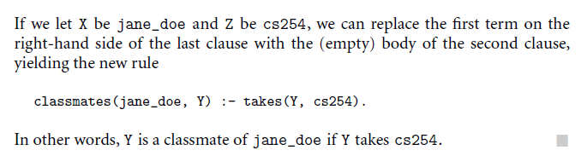
Another Example
takes(jane_doe, his201).
takes(jane_doe, cs245).
takes(ajit_chandra, art302).
takes(ajit_chandra, cs254).
classmates(X, Y) :- takes(X, Z), takes(Y, Z).
via resolution, yields the new rule:
classmates(jane_doe, Y) :- takes(Y, cs254).

Slide 15
Unification
Prolog associates variables and values using a process known as unification
  Variable that receive a value are said to be instantiated
Unification rules
  A constant unifies only with itself
  Two structures unify if and only if they have the same functor and the same number of arguments, and the corresponding arguments unify recursively
  A variable unifies to with anything

Slide 16
Equality
Equality is defined as unifiability
  An equality goal is using an infix predicate =
For instance,
  ?- dahl = dahl.
  Yes
  ?- dahl = curry.
  No
  ?- likes(Person, dahl) = likes(sam, Food).
  Person = sam
  Food = dahl ;
  No
  ?- likes(Person, curry) = likes(sam, Food).
  Person = sam
  Food = curry ;
  No

Slide 17
Equality
What is the results of
  ?- likes(Person, Food) = likes(sam, Food).
  Person = sam
  Food = _G158 ;
  No
Internal Representation for an
uninstantiated variable
Any instantiation proves the equality

Slide 18
Examples
For example we have following statements,
(1) If it is a pleasant day you will do strawberry picking
(2) If you are doing strawberry picking you are happy.
Above statements can be written in propositional logic like this -
(1) strawberry_picking ← pleasant
(2) happy ← strawberry_picking

Slide 19
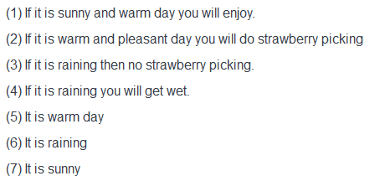
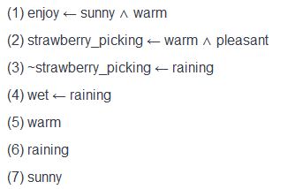
Examples

Slide 20
Resolution
Resolution is one kind of proof technique that works this way - (i) select two clauses that contain conflicting terms (ii) combine those two clauses and (iii) cancel out the conflicting terms.

Slide 21
Tracing
Tracing the execution of a Prolog query allows you to see all of the goals that are executed as part of the query, in sequence, along with whether or not they succeed. Tracing also allows you to see what steps occur as Prolog backtracks.
?- trace.
true.
When you are finished with tracing, turn it off using the "goal"
?- notrace.

Slide 22
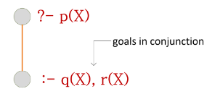
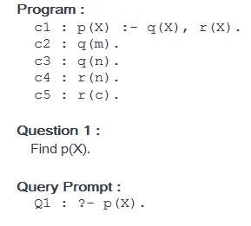
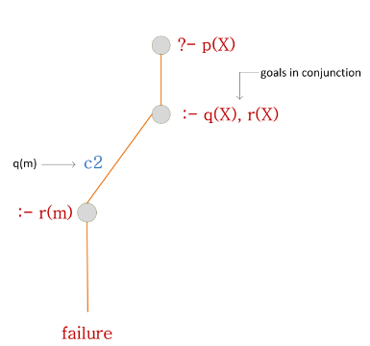
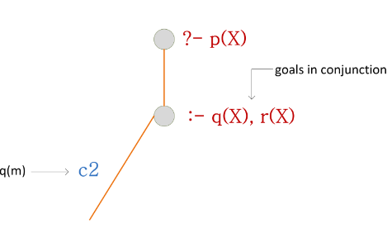
Tracing Example
Try to trace through the search process for given question.

Slide 23
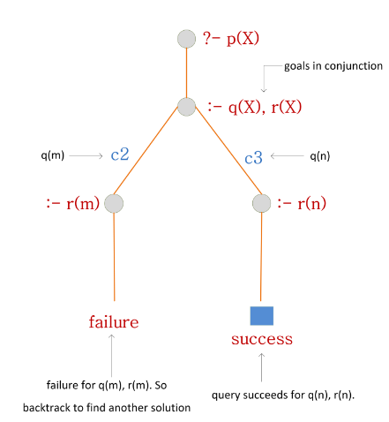
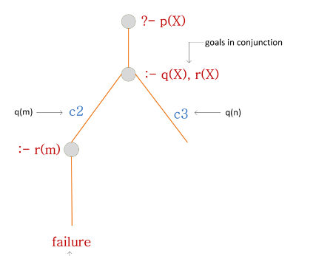

Slide 24
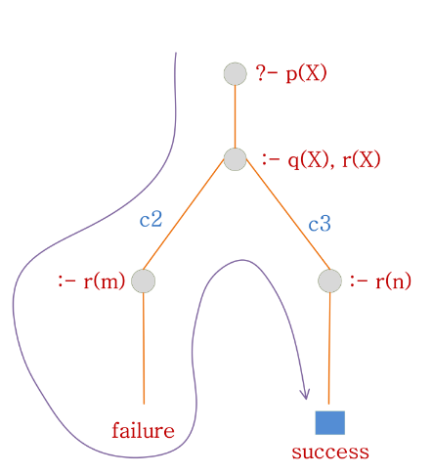

Slide 25
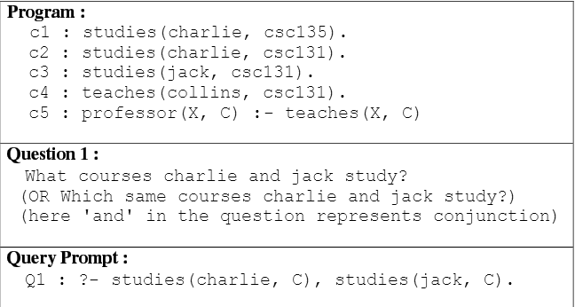
Another Example

Slide 26
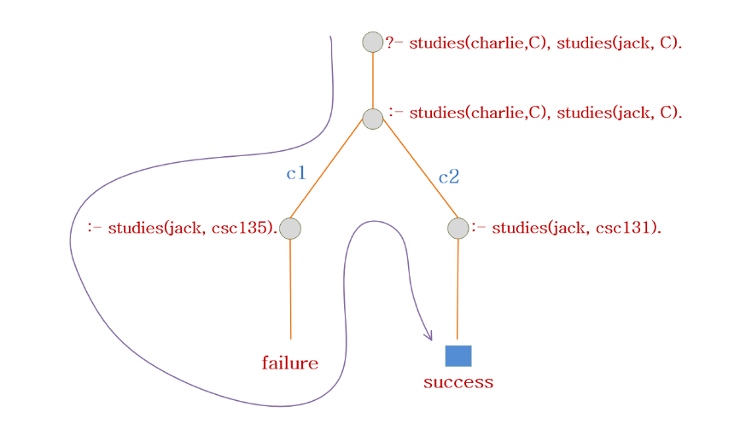
Solution

Slide 27
Prolog Examples
(6) What answers do you get for below queries for given program.
Program :
vegetarian(jose).
vegetarian(james).
vegetable(carrot).
vegetable(egg_plant).
likes(jose, X) :- vegetable(X).
loves(Who, egg_plant) :- vegetarian(Who).
Queries :
?- vegetable(X).
?- vegetable(potato).
?- vegetarian(_).
?- likes(jose, What).
?- likes(Who, egg_plant).
?- loves(Who, egg_plant).

Slide 28
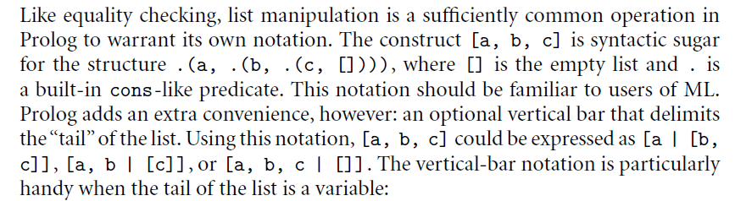
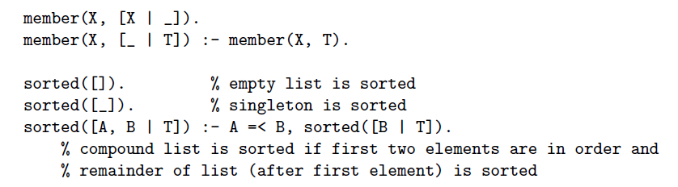
List notation in Prolog

Slide 29
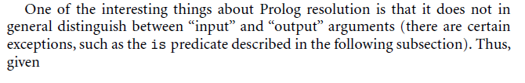
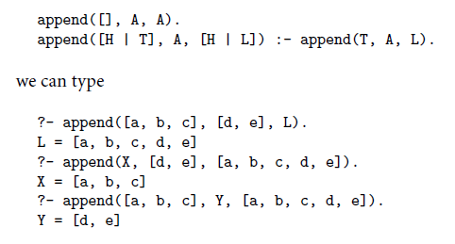
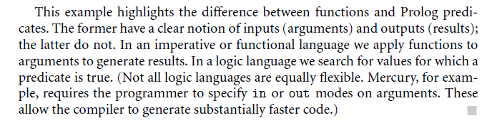
Functions, predicates, and two-way rules

Slide 30
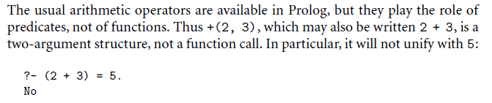
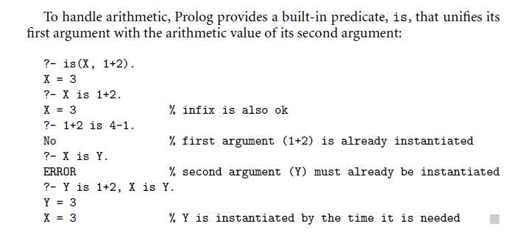
Arithmetic and the is predicate

Slide 31
Execution Order
Prolog searches for a resolution sequence that satisfies the goal
In order to satisfy the logical predicate, we can imagine two search strategies:
  Forward chaining, derived the goal from the axioms
  Backward chaining, start with the goal and attempt to resolve them working backwards
Backward chaining is usually more efficient, so it is the mechanism underlying the execution of Prolog programs
  Forward chaining is more efficient when the number of facts is small and the number of rules is very large

Slide 32
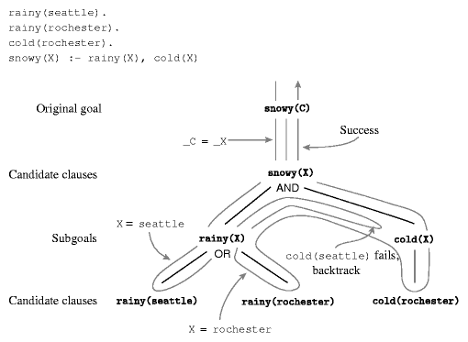
Backward Chaining in Prolog
Backward chaining follows a classic depth-first backtracking algorithm
Example
  Goal:
Snowy(C)

Slide 33
Depth-first backtracking
The search for a resolution is ordered and depth-first
  The behavior of the interpreter is predictable
Ordering is fundamental in recursion
  Recursion is again the basic computational technique, as it was in functional languages
  Inappropriate ordering of the terms may result in non-terminating resolutions (infinite regression)
  For example: Graph
edge(a,b). edge(b, c). edge(c, d).
edge(d,e). edge(b, e). edge(d, f).
path(X, X).
path(X, Y) :- edge(Z, Y), path(X, Z).
Correct

Slide 34
Depth-first backtracking
The search for a resolution is ordered and depth-first
  The behavior of the interpreter is predictable
Ordering is fundamental in recursion
  Recursion is again the basic computational technique, as it was in functional languages
  Inappropriate ordering of the terms may result in non-terminating resolutions (infinite regression)
  For example: Graph
edge(a,b). edge(b, c). edge(c, d).
edge(d,e). edge(b, e). edge(d, f).
path(X, Y) :- path(X, Z), edge(Z, Y).
path(X, X).
Incorrect

Slide 35
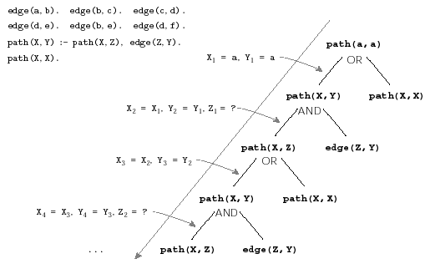
Infinite Regression
Goal

Slide 36
Examples
Genealogy
  http://ktiml.mff.cuni.cz/~bartak/prolog/genealogy.html
Data structures and arithmetic
  Prolog has an arithmetic functor is that unifies arithmetic values
    E.g. is (X, 1+2), X is 1+2
  Dates example
    http://ktiml.mff.cuni.cz/~bartak/prolog/basic_struct.html

